Slide 1
SMART TOURS
Museum
Team 4
Ramesh Gorantla * Nagarjuna Kalluri * Soham Dasgupta * Debarati Bhattacharyya

Slide 2
AGENDA
MOTIVATION
ABOUT SMART TOURS
TOOLS & TECHNOLOGIES
PROJECT WORKFLOW
COMPARE & CONTRAST
DEMO UI & QUERY
FUTURE WORK

Slide 3
MOTIVATION
With the advancement of Semantic Web Technologies, museums and several similar organizations worldwide have shared their collections metadata as machine-readable linked data over the internet
This application of Linked Open Data enables the artworks to be found and accessed by population across the globe
Coupled with the use of W3C open data standard, RDF and SPARQL, linked open data provides developers and researchers the ability to access and re-use such data for creating alternative applications, devices, interfaces etc.
Over the time since around 2014, a lot of museums and art galleries have leveraged the concepts of Semantic Web and published their database on the cloud so that it is readily available to the world
But the experience so far demonstrates that publishing museum data to the linked data cloud is difficult : the databases are large and complex, the information is richly structured and varies from museum to museum, and it is difficult to link the data to other datasets.

Slide 4
WHAT IS SMART TOURS
Smart Tours is a minor attempt from our end to experience and solve to some extent the challenges associated with publishing and using information on the Linked Open Data (LOD)
A common problem encountered by all of us while visiting museums is the lack of information displayed alongside the artifacts which often prohibits us to fully realize its historical importance
In some cases, artifacts may not be found at their designated locations or the viewer may be interested in exploring a particular section of the museum as per his interest
Our project aims at solving these issues by creating an application which uses Linked data, Ontology techniques and other Semantic Web Techniques to provide viewers an improved and interesting tour of the museums
Our application intends to aid people visiting museums and provide all this information at the fingertips of the viewer

Slide 5
TOOLS AND TECHNOLOGIES
PROTEGE
Ontology generation
Data preprocessing
RDF generation
APACHE JENA
Uploading datasets & SPARQL querying
HTML, CSS, ANGULAR, BOOTSTRAP
User Interface design and implementation

Slide 6
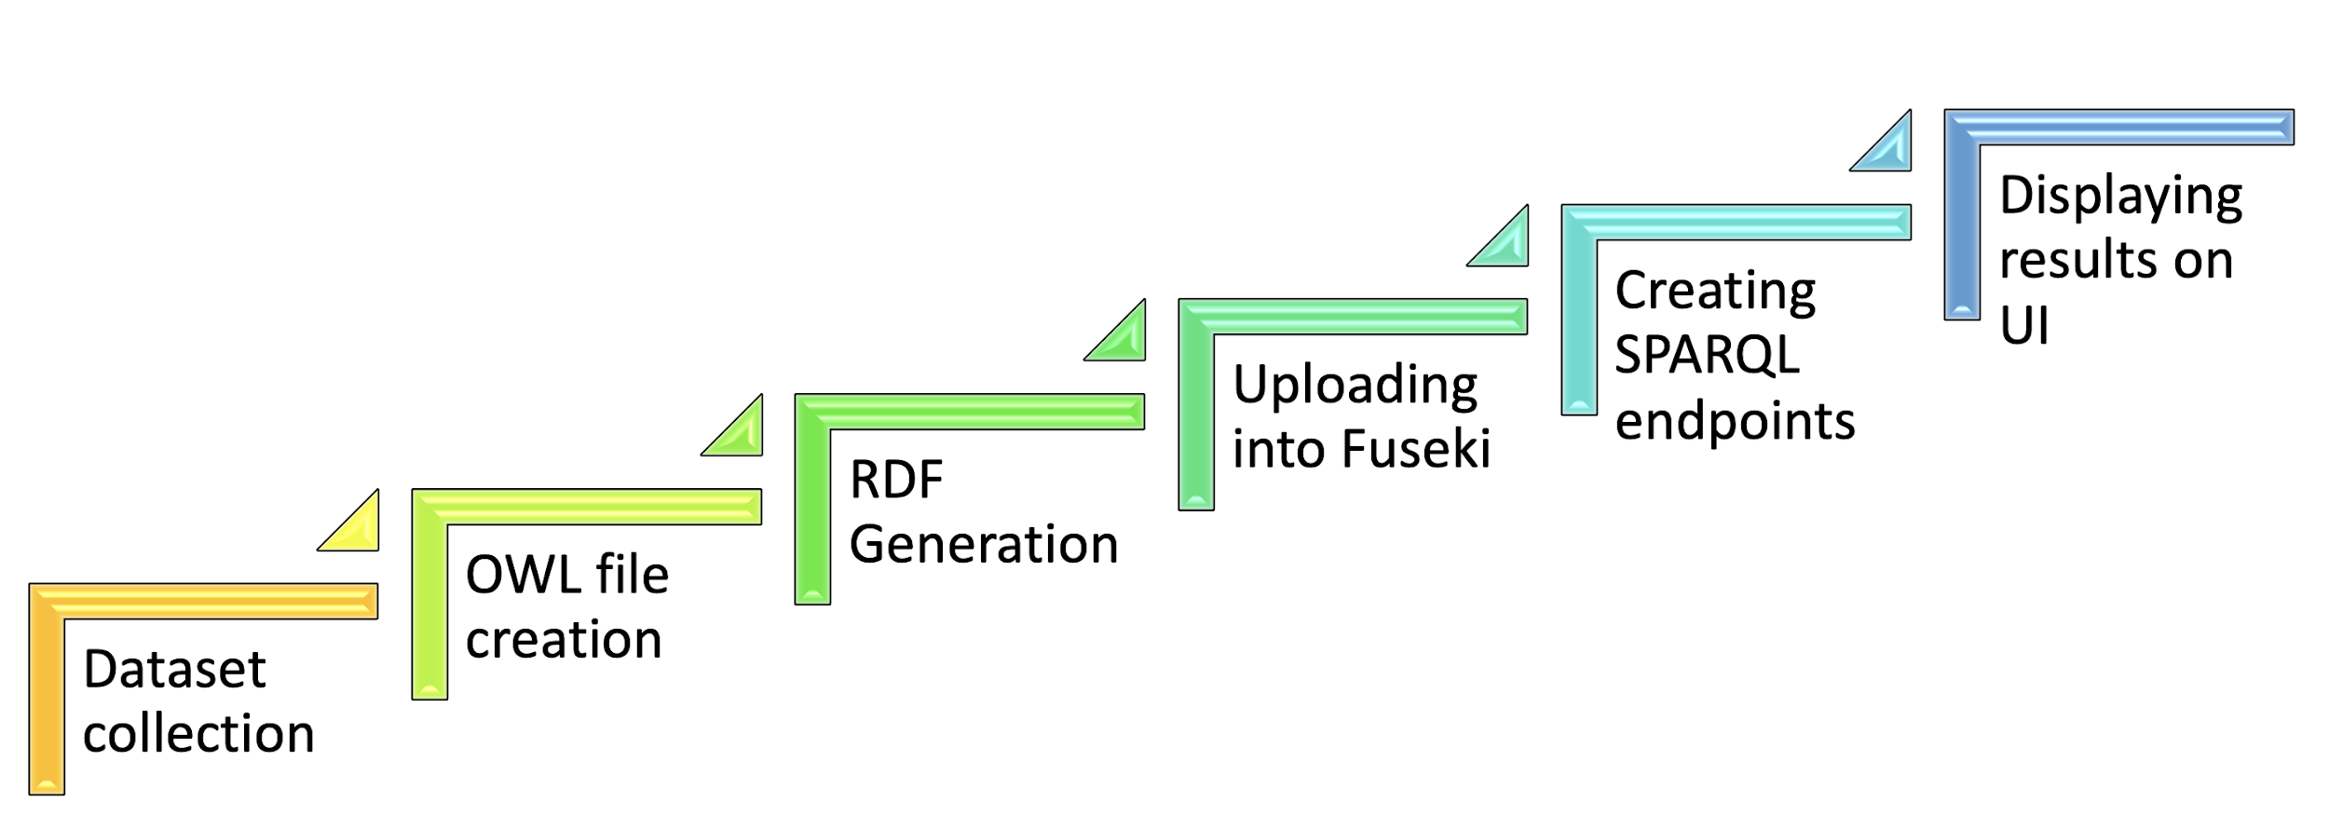
PROJECT WORKFLOW

Slide 7
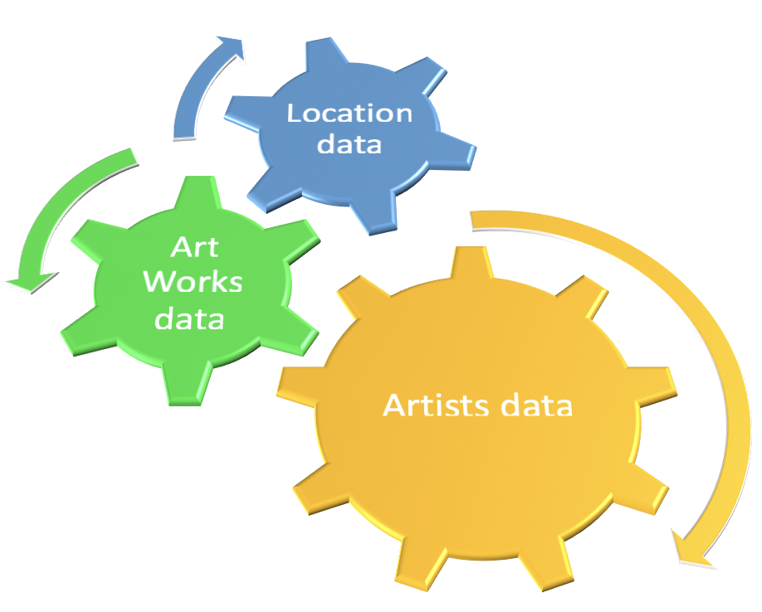
DATASETS
LOCATION DATA
Random location (latlong) data generated using python scripts
ARTWORKS DATA
Museum of Modern Art (MoMA) (https://doi.org/10.5281/zenodo.1439879)
ARTISTS DATA
Museum of Modern Art (MoMA) (https://doi.org/10.5281/zenodo.1439879)

Slide 8
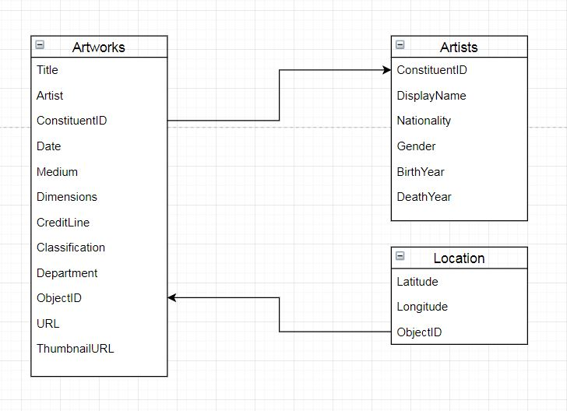
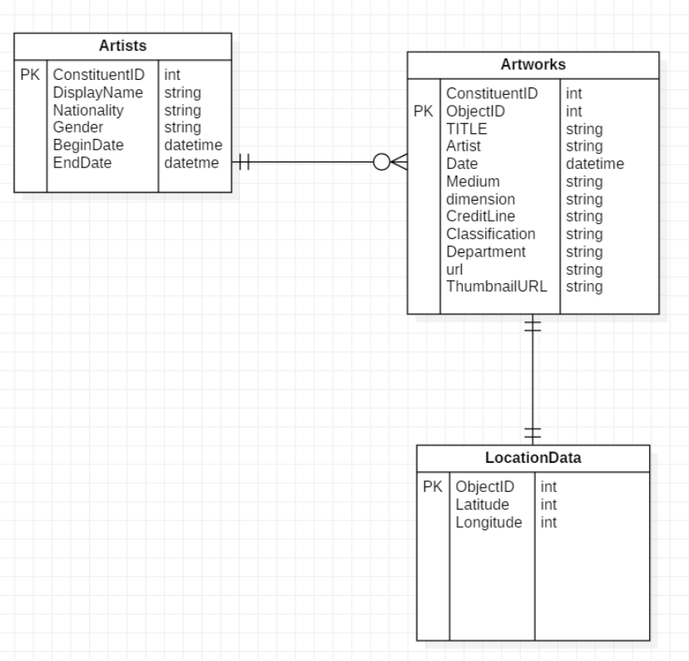
DATASETS

Slide 9
COMPARE & CONTRAST
Existing
Most of the museums have static content tours like giving a booklet
Some museums started using smart devices like a tablet, which gives information about the artifacts in a particular room or entire museum
Both the above approaches requires user to search for an artifact to get more information
Our solution
We are building a web/mobile app, which gets user location and displays the artifact/ nearby artifacts the user is looking at
Notes:
Lessons Learned in Building Linked Data for the American Art Collaborative
Connecting the Smithsonian American Art Museum to the Linked Data Cloud
Applied the lessons in:
Data Preparation such as filtering table
Mapping metadata to RDF format
Link to External sources such as DBPedia
Reuse ontology terminologies
Using Karma to map our data to RDF

Slide 10
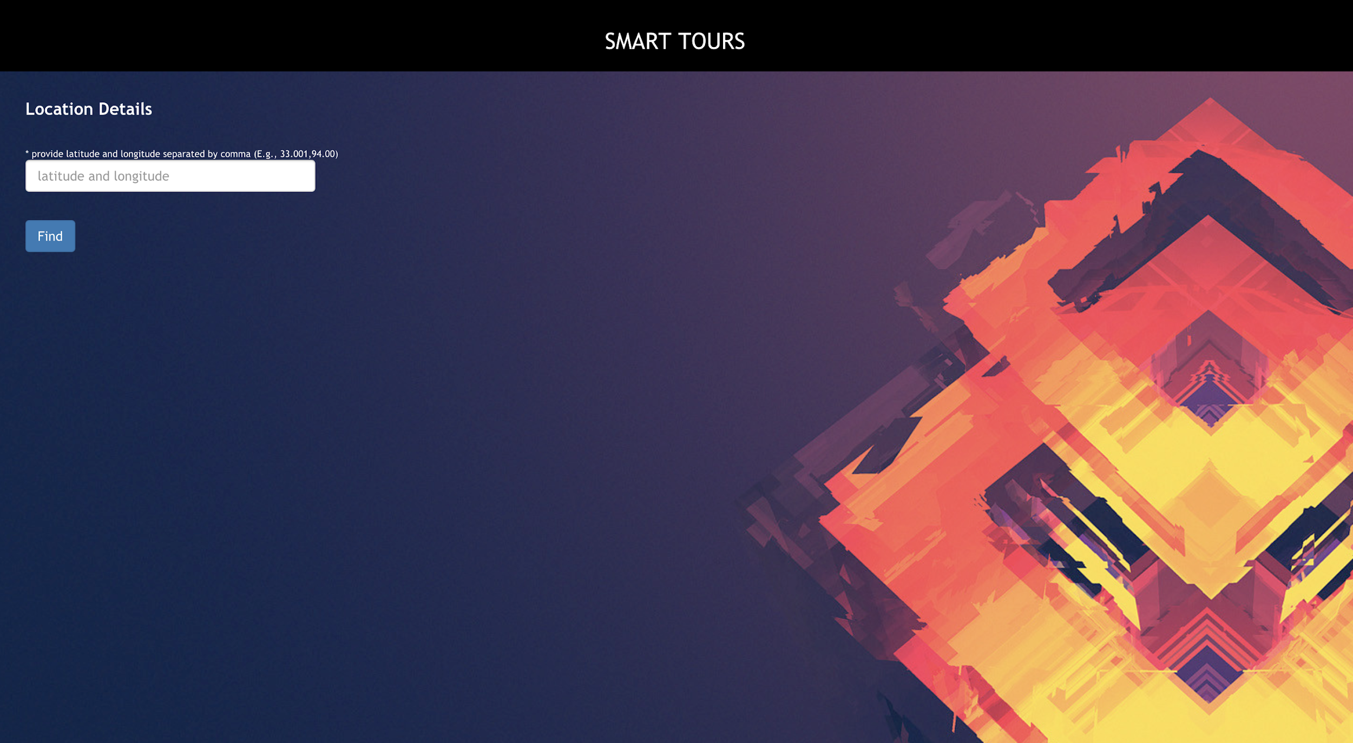
User Interface

Slide 11
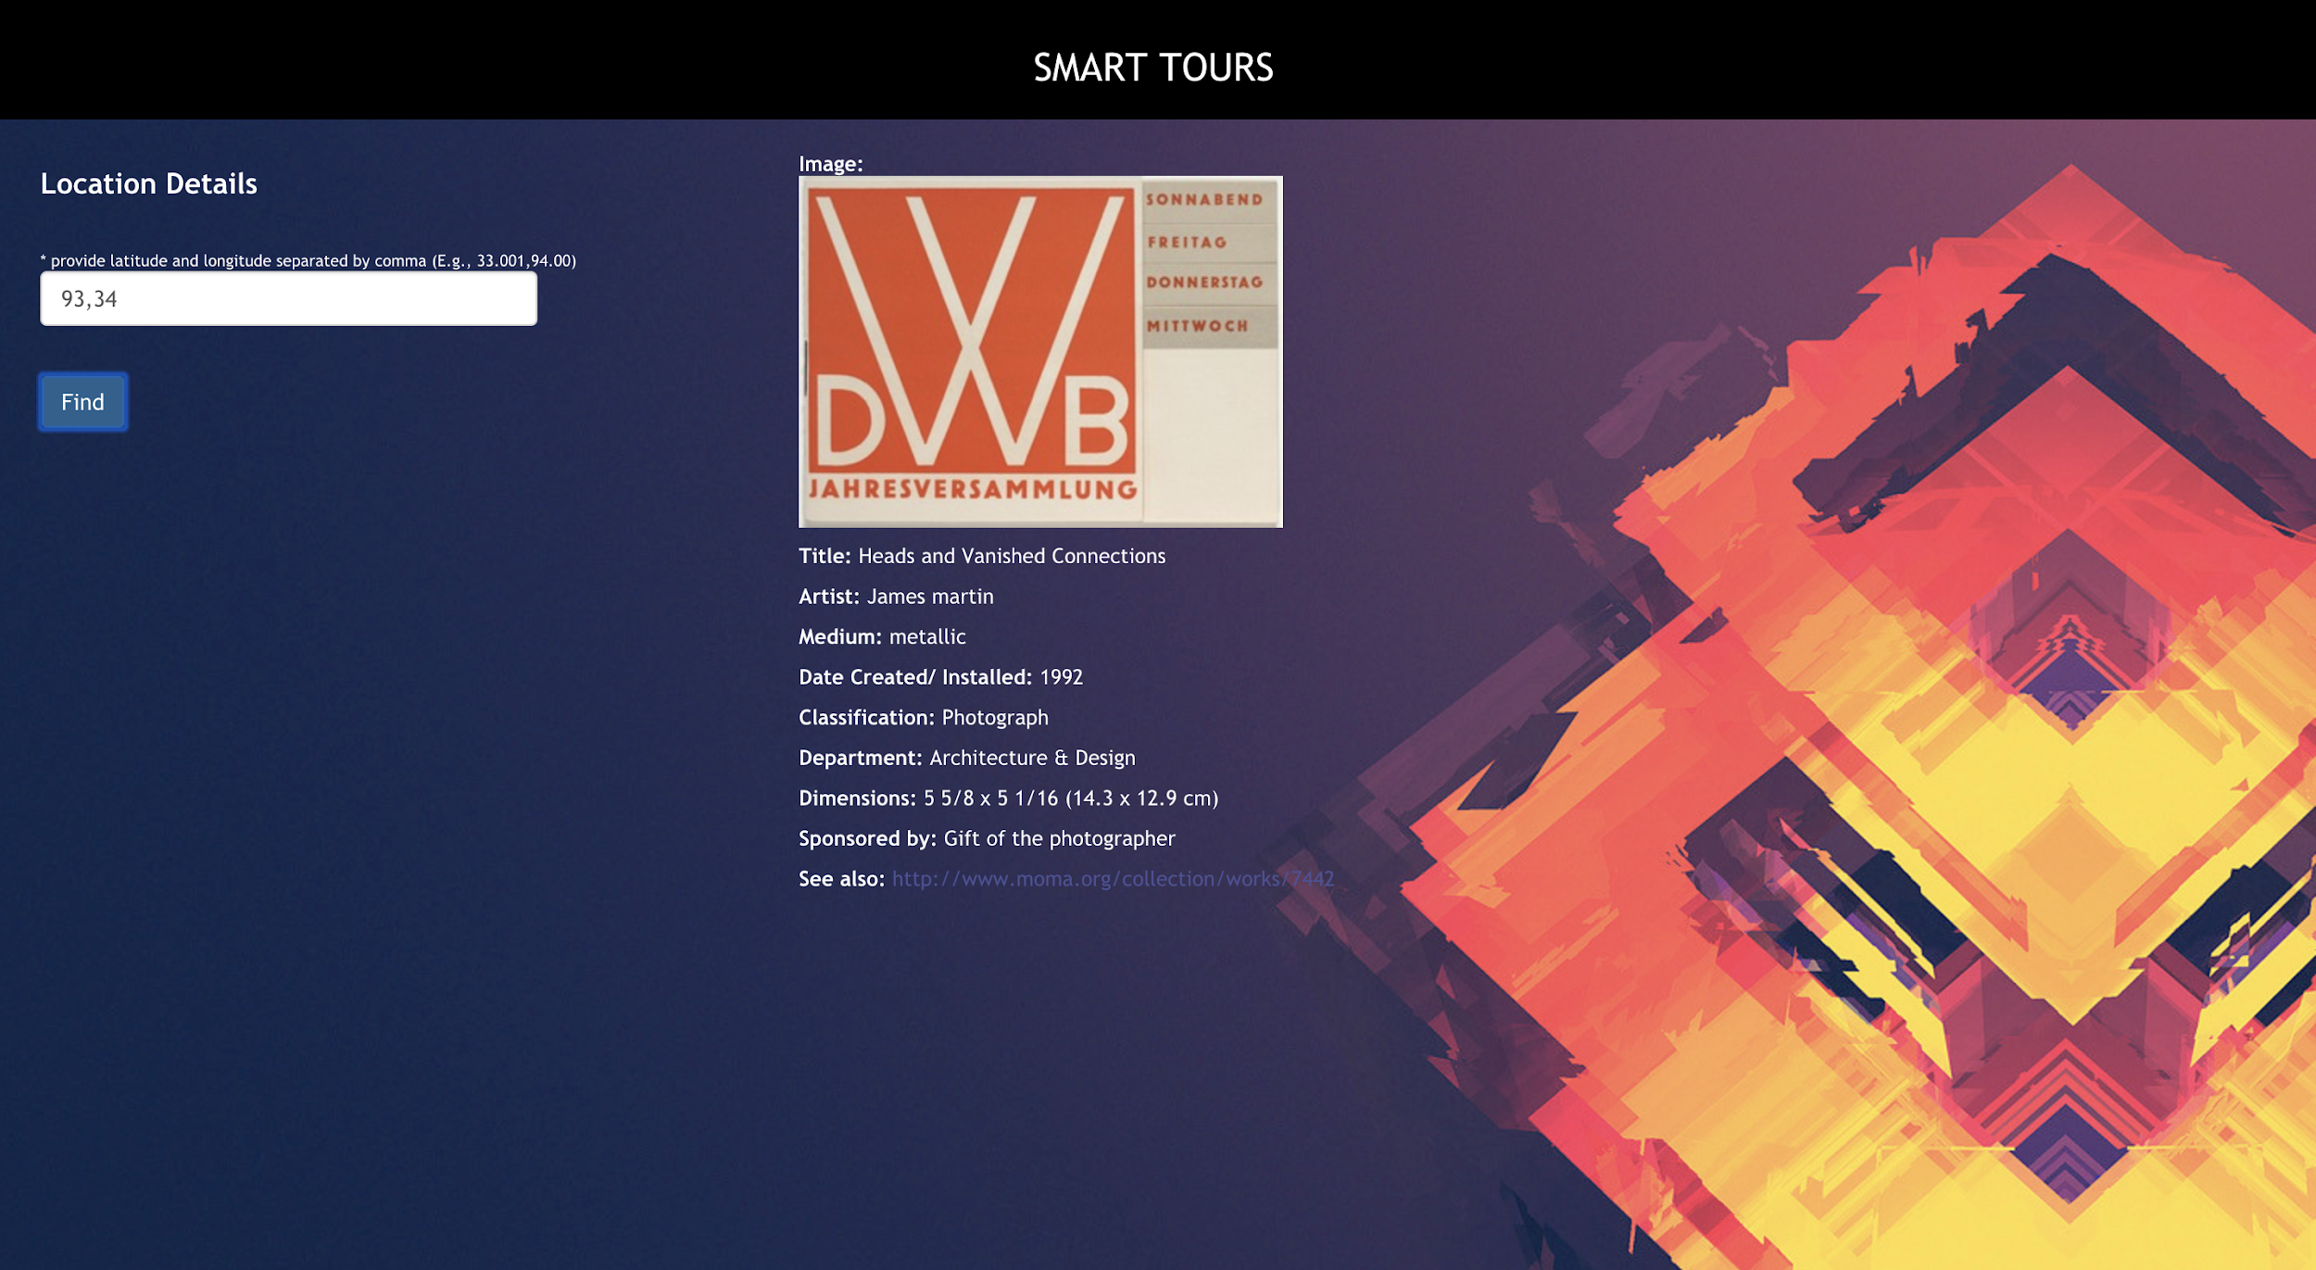
User Interface

Slide 12
Sparql query

Slide 13
DEMO

Slide 14
FUTURE WORK
Integrating the application with public datasets like DBPedia or other public datasets, to show the news/information about the artifacts or artists
Implementation the approximation algorithm to finding nearby artifacts if the location of the user is not accurate
Building a mobile application for Android/iOS

Slide 15
TEAM
Team Member | Contribution
Ramesh Gorantla | Data collection, preprocessing, Front end Development, Ontology creation and RDF generation using Protege Cellfie, OWL validation, Sparql querying using Fuseki, Report Writing and Editing
Nagarjuna Kalluri | Data collection, preprocessing, Front end Development, Ontology creation and RDF generation using OpenRefine, Sparql querying using Fuseki, Report Writing and Editing
Soham Dasgupta | Data collection, preprocessing, RDF generation using Karma, Apache Fuseki Installation and Configuration, Sparql querying using Fuseki, Report Writing and Editing
Debarati Bhattacharyya | Ontology Validation, Apache Fuseki Installation and Configuration, Sparql querying using Fuseki, Report Writing and Editing

Slide 16
REFERENCES
Linked Open Data at SAAM : https://americanart.si.edu/about/lod
Connecting the smithsonian american art museum to the linked data cloud by P Szekely, CA
Knoblock, et al at the Extended Semantic Web Conference (2013)
Lessons Learned in Building Linked Data for the American Art Collaborative by CA Knoblock, PSzekely, etal in Intl. Semantic Web Conference (2017)
Amsterdam Museum of Linked Open Data by B Victor et al in Journal of Semantic Web (2013)

Slide 17
THANK YOU

